Slide 1
Food Order Management System
25BCE10200 Shaurya Thapa
25BCE10487 Deepaansh Kapoor
25BCE10482 Aryaman Saxena
25BCE10525 Suyash Kapse
DBMS Project Presentation
Notes:
Open with: this project takes a real food-order dataset and turns it into a properly designed relational database, using every concept from Module 2.

Slide 2
Project at a glance
1,898
~1,200
~178
14
food orders
customers
restaurants
cuisine types
Part 1
Relational model & keys
Part 2
ER Diagram
Part 3
Normalization
Notes:
Dataset numbers come from the repo README. Walk through the 4 module blocks as the roadmap of the talk.

Slide 3
Relational model: terms mapped to our project
Term | Meaning | In our project
Relation | A table | orders, customers, restaurants
Tuple | A row | One food order
Attribute | A column | cost_of_order, rating
Domain | Set of allowed values | rating: 1 to 5; day_of_week: Weekday / Weekend
Degree, Cardinality | No. of columns, no. of rows | orders: degree 9, cardinality 1,898
Relational schema | R(A1, A2, ... An) | orders(order_id, customer_id, restaurant_id, ...)
Notes:
Domain = set of legal values. Degree = number of columns, cardinality = number of rows.

Slide 4
Relational schema with PK and FK
customers
restaurants
cuisines
Primary Key-- customer_id
Primary Key-- restaurant_id
Primary Key-- cuisine_id
orders
restaurant_cuisine
order_audit
Primary Key-- order_id
Foreign Key-- customer_id
Foreign Key-- restaurant_id
Foreign Key-- cuisine_id
Primary Key, Foreign Key-- restaurant_id
Primary Key, Foreign Key-- cuisine_id
Primary Key-- audit_id
Restaurant and Cuisines have M:N relationship , which is resolved using associative entity Restaurant_cuisine…
Notes:
Column names follow the dataset; keep them identical to 01_schema.sql when presenting. Crows-foot not required: just explain 1:N and M:N.

Slide 5
Keys and integrity rules
Key | Example
Super key | {order_id, rating}
Candidate key | order_id
Primary key | order_id
Composite key | (restaurant_id, cuisine_id)
Alternate key | restaurant_name (UNIQUE)
Foreign key | orders.customer_id
Entity integrity
PK is never NULL and never repeats.
Referential integrity
Every FK matches an existing PK.
Domain integrity
Data types + CHECK, e.g. cost_of_order > 0.
Notes:
Entity integrity: PK not NULL. Referential integrity: FK value must exist in parent table or be NULL. Domain integrity: CHECK/data types.

Slide 6
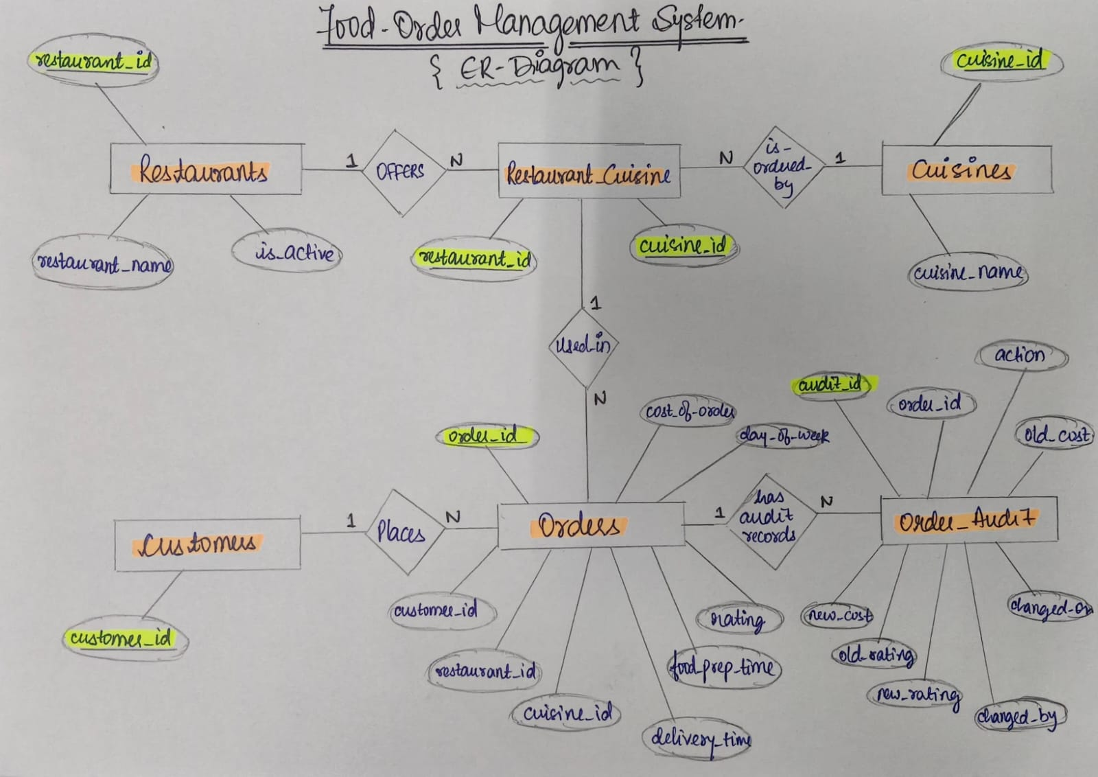
ER Diagram
Notes:
Selection filters rows, projection picks columns. Union/intersection/difference need union-compatible relations.

Slide 7
Before Normalization
The raw dataset stores all order information in a single table.
order_id | customer_id | restaurant_name | cuisine_type | cost | day | rating
1001 | 501 | ABC Restaurant | Indian | 25 | Weekday | 5
1002 | 502 | ABC Restaurant | Indian | 40 | Weekend | 4
1003 | 501 | ABC Restaurant | Chinese | 30 | Weekday | 5
1004 | 503 | XYZ Restaurant | Italian | 50 | Weekend | 3
Problems Identified
Objective
Restaurant and cuisine names are repeated
Redundancy grows with the number of orders
Changing restaurant info needs many updates
Update, insertion and deletion anomalies
Decompose into logically related tables
Preserve data integrity
Notes:
Rows are illustrative, taken from the README example. 178 restaurants are repeated across 1,898 order rows.

Slide 8
Functional Dependencies,1NF & 2NF
Functional Dependency
order_id → customer_id, restaurant_name, cuisine_type, cost, day, rating, preparation_time, delivery_time
One order_id uniquely determines all details of that order
After decomposition: restaurant_id → restaurant_name; cuisine_id → cuisine_name
1NF — First Normal Form
2NF — Second Normal Form
All values are atomic
No repeating groups
order_id uniquely identifies each row
Result: already in 1NF ✓
Must be in 1NF
No partial dependency on a composite key
Primary key order_id is a single column
Result: already in 2NF ✓
Notes:
Single-column PK means partial dependency cannot exist, so 2NF is automatic. 3NF work is the real decomposition.

Slide 9
3NF : Removing Redundancy
Restaurant and cuisine details were repeated in every order, so we separate them into independent tables.
CUSTOMERS
RESTAURANTS
CUISINES
customer_id
501
502
503
restaurant_id | restaurant_name
1 | ABC Restaurant
2 | XYZ Restaurant
cuisine_id | cuisine_name
1 | Indian
2 | Chinese
3 | Italian
ORDERS
order_id | customer_id | restaurant_id | cuisine_id | cost
1001 | 501 | 1 | 1 | 25
1002 | 502 | 1 | 1 | 40
1003 | 501 | 1 | 2 | 30
1004 | 503 | 2 | 3 | 50
Descriptive data now lives in independent entities.
3NF ✓
Notes:
Single-column PK means partial dependency cannot exist, so 2NF is automatic. 3NF work is the real decomposition.

Slide 10
Restaurant-Cuisine Relationship & 4NF
restaurant_cuisine (bridge table)
Why another table?
restaurant_id | cuisine_id
1 | 1
1 | 2
1 | 3
2 | 1
3 | 1
A restaurant serves many cuisines
A cuisine is served by many restaurants
Restaurant ↔ Cuisine = M : N
Keys
4NF Result
Composite PK: (restaurant_id, cuisine_id)
Both columns are also foreign keys
Restaurant 1:N bridge N:1 Cuisine
Independent multi-valued Restaurant–Cuisine relationship is moved into its own relation
4NF ✓
Notes:
Single-column PK means partial dependency cannot exist, so 2NF is automatic. 3NF work is the real decomposition.

Slide 11
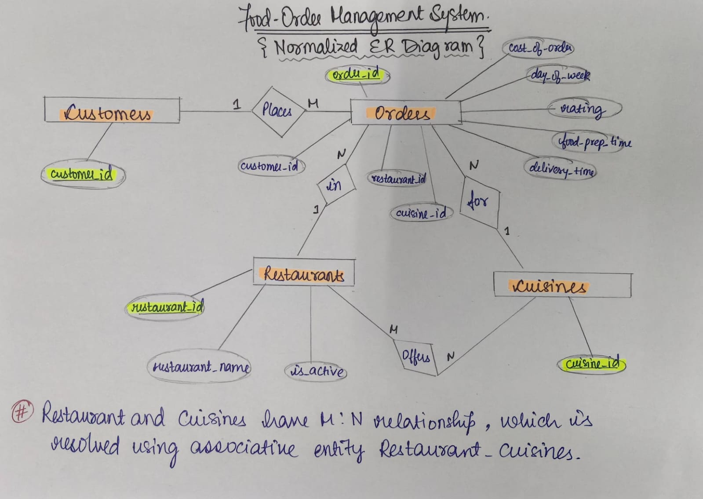
Normalized-- ER Diagram
Notes:
Selection filters rows, projection picks columns. Union/intersection/difference need union-compatible relations.

